Slide 1
Overview of IBM and Numerical Considerations

Slide 2
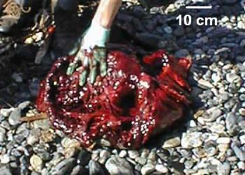
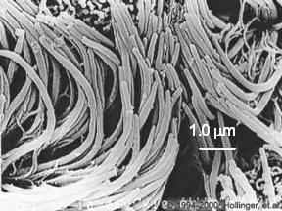
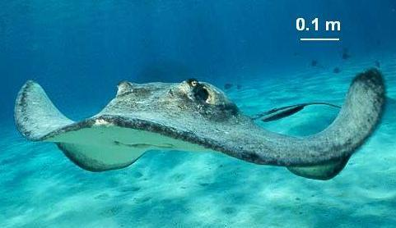
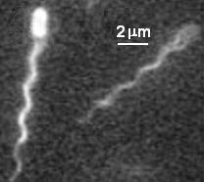
Fluid-Structure Interaction
High Reynolds numbers
Low Reynolds numbers
Whale heart: chambered pump
Cilia in the respiratory tract: micropumps
Cayman stingray: flapping locomotion
E. coli: flagellar locomotion

Slide 3
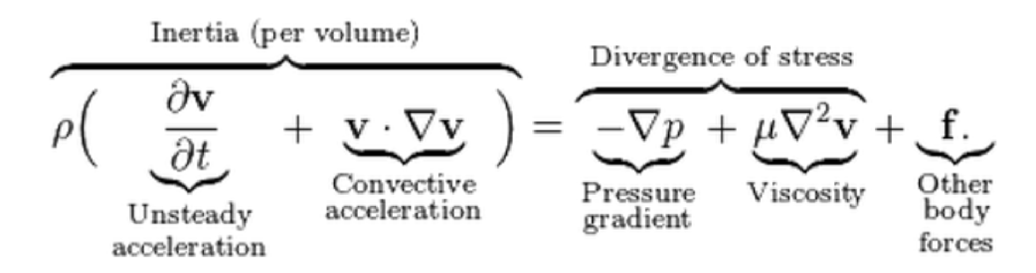
Modeling the fluid: Navier-Stokes equations
This is essentially F = ma for a parcel of fluid.
Let v(x,t) give the velocity at position x and time t.
Let p(x,t) be the pressure at position x and time t.
ρ is the density of the fluid, and μ is the viscosity of the fluid.

Slide 4
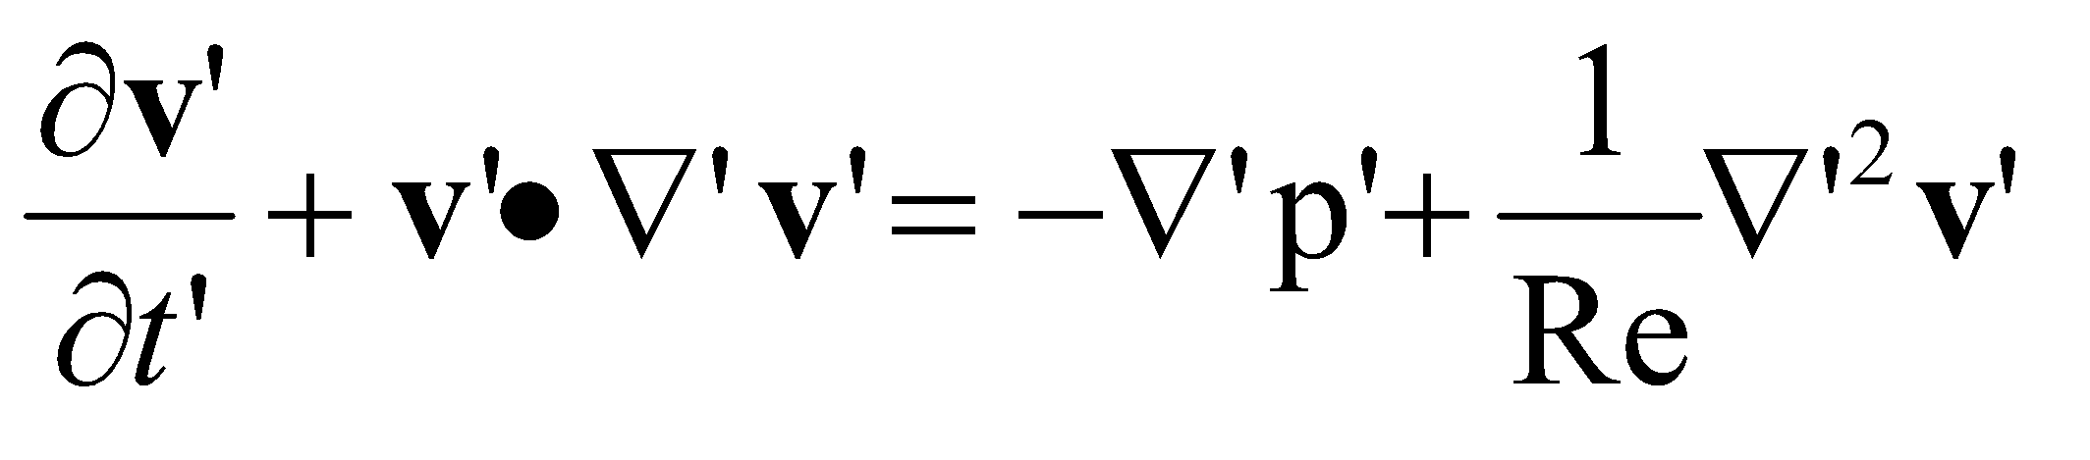



Describing the fluid: Non-dimensional Navier-Stokes equations
The Navier-Stokes equation can be put into dimensionless
form using the following definitions:
L is the characteristic length
Ex: length of a wing
V is the characteristic velocity
Ex: max velocity of wing tip

Slide 5
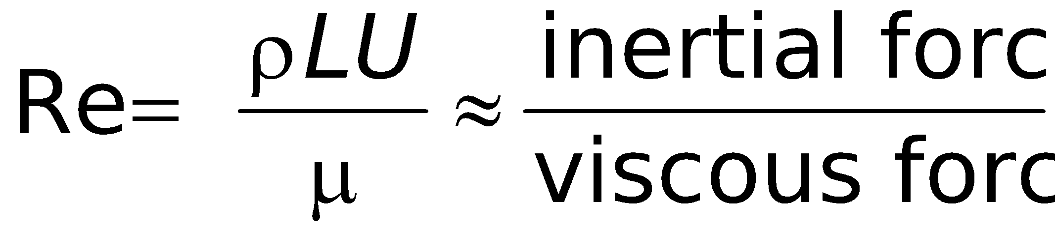
Reynolds number
Flows of the same Re are dynamically similar.
Physical models are scaled to the same Re.
Bigger models of small organisms can be made by increasing the viscosity of the fluid.
Smaller models of bigger organisms can be made by reducing viscosity or increasing velocity.

Slide 6
Describing the boundary
In the immersed boundary method, boundaries are always elastic.
They can be stiff enough that they act like rigid objects.
They can be moved in prescribed ways using target points.
Boundaries have been modeled to resist bending, stretching, and twisting.
All of these properties can change in time in prescribed ways or according to other models.

Slide 7
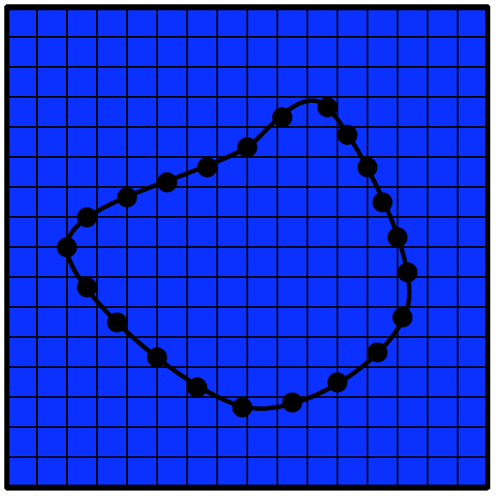
Immersed boundary approach to
fluid-structure interaction
Discretize the Eulerian equations on a Cartesian grid. Solve for velocity and pressure.
Discretize the Lagrangian equations on a curvilinear mesh. Solve for force density and position.
Lagrangian description
X(r,t), F(r,t)
Eulerian description
u(x,t), p(x,t), f(x,t)
Notes:
Now let’s move to what we can call numerical experiments.
How do we simulate this fluid structure interaction? We will use the immersed boundary framework introduced by Peskin for working on the adult heart.
We have an Eulerian description of the viscous, incompressible fluid, and a Lagrangrian description of the immersed elastic stucture.
Go through variables.
Note there is no body conforming moving grid for the fluid.

Slide 8
Numerical method
At each time step:
Solve the equations of fluid motion defined on the Eulerian grid with elastic body force density f(x,t).
Move the boundary at the local fluid velocity. Determine the velocity at each Lagrangian point through interpolation.
Forces exerted on the fluid by the boundary are determined using the elastic deformation of the boundary.
Spread the force from the boundary to the Eulerian grid to obtain the elastic body force density used in the next time step.
Notes:
The immersed boundary method is both a mathematical formulation of this problem and a numerical method.
Let me walk through the steps we take for each time step in the method before moving to the details.

Slide 9
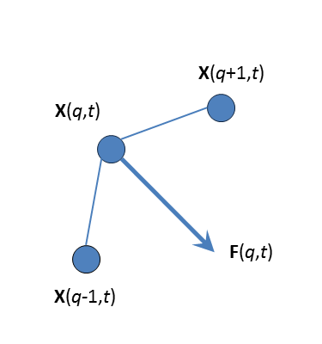


Spread the elastic force density from the curvilinear mesh onto the Cartesian grid
Notes:
The integral is discretized into a sum, and the delta function is discretized into a discrete delta function.
Here is a section of a boundary that resists bending, with the resulting force acting on the fluid from material point q.

Slide 10
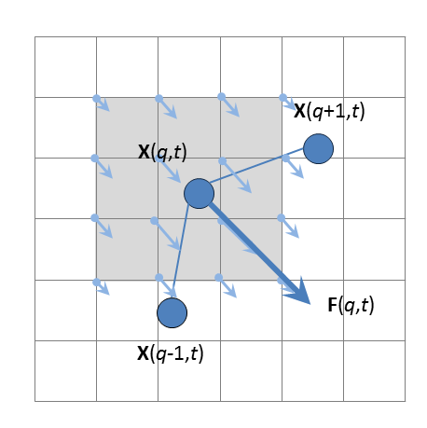
Spread the elastic force density from the curvilinear mesh onto the Cartesian grid
Notes:
Delta function weights are used to determine how much force is applied to nearby grid cells.

Slide 11
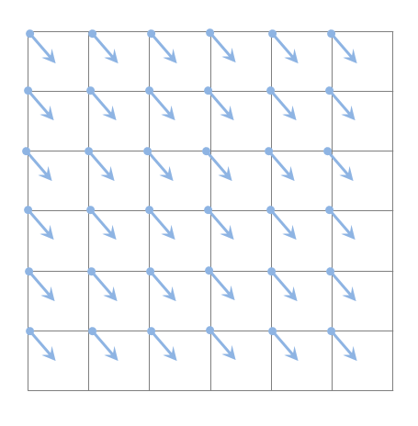


Interpolate the velocity field from the Cartesian grid onto the curvilinear mesh
Notes:
We also use this discrete delta function for the velocity interpolation from the Cartesian grid to the curvilinear mesh.
At a given time step, we know the velocity at each grid cell.

Slide 12
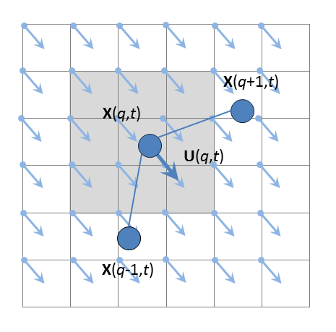
Interpolate the velocity field from the Cartesian grid onto the curvilinear mesh
Notes:
We obtain the velocity at material point q by summing nearby velocities multiplied by the discrete delta functions evaluated at the position of the Eulerian grid cell minus the position of the boundary.

Slide 13
Numerical analysis – key ideas
Numerical analysis is not only the design of numerical methods, but also their analysis. Three central concepts in this analysis are:
convergence: whether the method approximates the solution,
order: how well it approximates the solution, and
stability: whether errors are damped out.

Slide 14
Numerical instability
instability. Typically, algorithms would approach the right solution in the limit, if there were no round-off or truncation errors, but depending on the specific computational method, errors can be magnified, instead of damped, causing the error to grow exponentially.

Slide 15
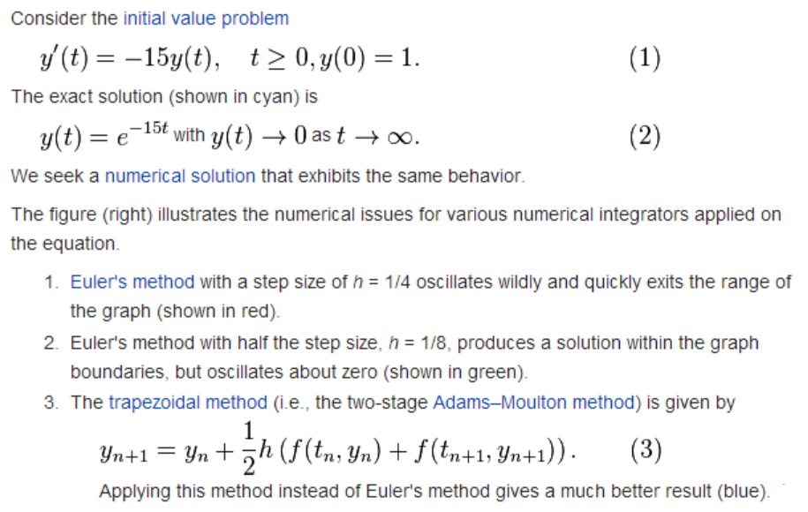
Motivating example

Slide 16
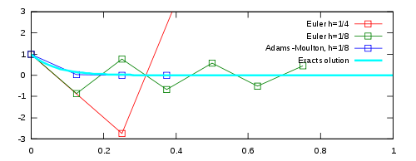
Instability
Download stiff_ode_example.m on github in the MATLAB codes folder.
stiff_ode_example(dt, tfinal)
dt is the time step size and tfinal is the final time.
Try the following parameter values to observe the instability:
stiff_ode_example(0.2, 1)
stiff_ode_example(0.1, 1)
stiff_ode_example(0.01, 1)

Slide 17
IBAMR instabilities
Instabilities typically occur when the time step is too big.
The time step necessary for stability is inversely proportional to the force applied to the fluid.
The forcing term is typically what causes the instability (not the CFL condition).
Strategy: Avoid large forces by minimizing accelerations and very stiff springs.

Slide 18

Courant–Friedrichs–Lewy condition
(CFL condition)
The Courant–Friedrichs–Lewy condition (CFL condition) is a necessary condition for stability while solving certain partial differential equations (usually hyperbolic PDEs) numerically by the method of finite differences.
The general CFL condition for the n-dimensional case is the following one:
Typically Cmax = 1.
In IBAMR, we rarely have to worry about this.

Slide 19
Convergence
A numerical method is said to be convergent if the numerical solution approaches the exact solution as the step size h goes to 0.
In the immersed boundary method you typically need to worry about convergence in space.
Is the flow around the boundary well resolved? Are shed vortices well resolved?

Slide 20

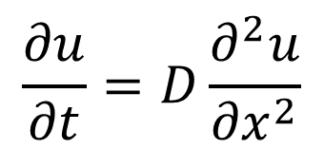
Heat equation
To look at an example that incorporates issues of instability and convergence in space and time, we will simulate the heat equation.
Download heat_equation.m on github.
Let u(x,t) give the temperature at time t and position x along a 1D bar.

Slide 21
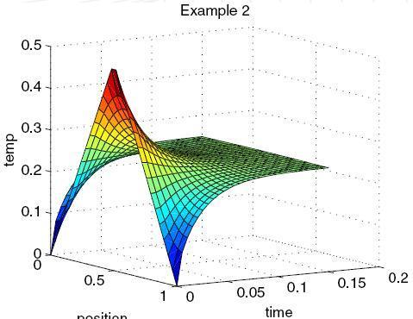
Heat equation
This script implement a finite difference scheme for the heat equation with D = 1.
Both analytical and numerical solutions are plotted at a single time (t = 0.1).
Intuitively, this is like modeling the heat distribution on a bar with hot spots.
Over time the heat diffuses.

Slide 22
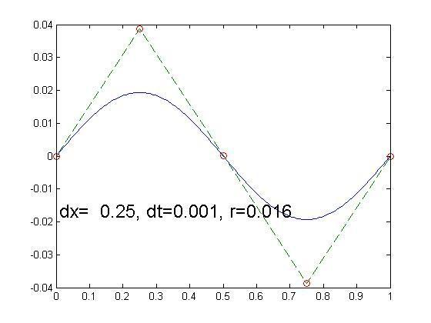
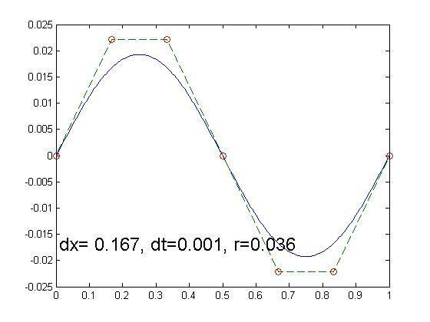
Heat equation
Type heat_equation(n,T) in the MATLAB command window where n = the number of spatial steps and T = the number of time steps.
Try the following parameters to show convergence in space:
Set T = 100.
Try n = 3, 5, 10, 20.

Slide 23
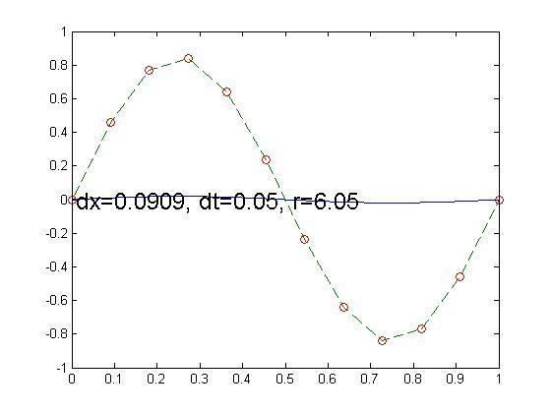
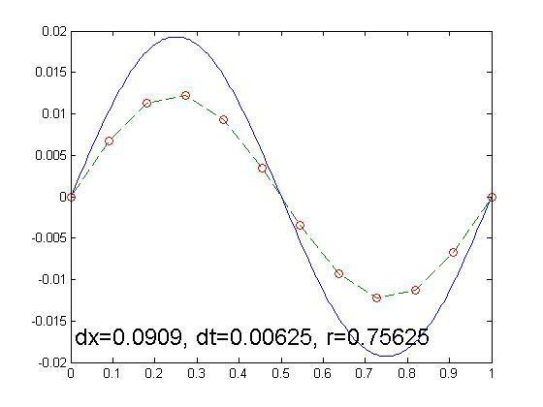
Heat equation
Now we will consider instability due to too large of a time step, as well as convergence in time.
Set n = 10.
Try T = 2, 4, 8, 16, 32, 64
Since the simulation runs until time = 0.1, dt = 0.1/T.

Slide 24
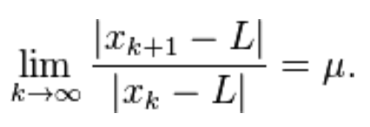
Rate of convergence
In numerical analysis, the speed at which a convergent sequence approaches its limit is called the rate of convergence.
Suppose that the sequence {x_{k}} converges to the number L.
We say that this sequence converges linearly to L, if there exists a number μ ∈ (0, 1) such that
The number μ is called the rate of convergence.

Slide 25

Order of convergence
The sequence converges with order q to L for q>1 if
In particular, if it convergences with order
q = 2, it is called quadratic convergence,
q = 3, it is called cubic convergence

Slide 26
Immersed boundary method
Old idea was that you want 2 boundary points for every fluid grid point.
This may not be the best choice now.
IBFE use a 1:1 ratio.
Second order in space if smooth boundaries.
First order in space if edges.
Typically use 512x512 grids for fluid domain.
Time step either first or second order, depending on version.
Typically use dt = 10^-5 or 10^-6, when characteristic time is t = 1.
For example, one wing stroke every 1 unit in time.

Slide 27
IBAMR – How it speeds things up
IBAMR is a parallelized and adaptive version of the immersed boundary method.
This is a major coding challenge!
The spatial grid of the fluid is locally refined near the boundaries and regions of high vorticity.

Slide 28
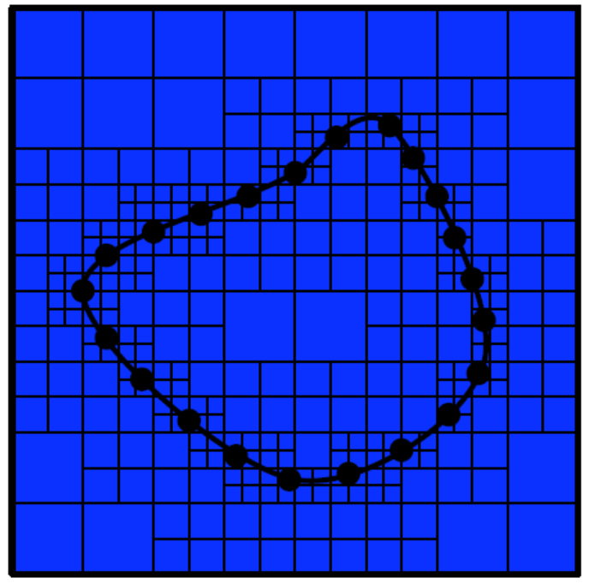
The basic immersed boundary approach to fluid-structure interaction
Discretize the Eulerian equations on a Cartesian grid
Refine the Cartesian grid near the boundary
Discretize the Lagrangian equations on a moving curvilinear mesh
Curvilinear mesh always at same refinement level
Fluid-structure coupling via regularized delta functions
Boyce Griffith, http://mbi.osu.edu/2009/ctwmaterials/griffith.pdf

Slide 29
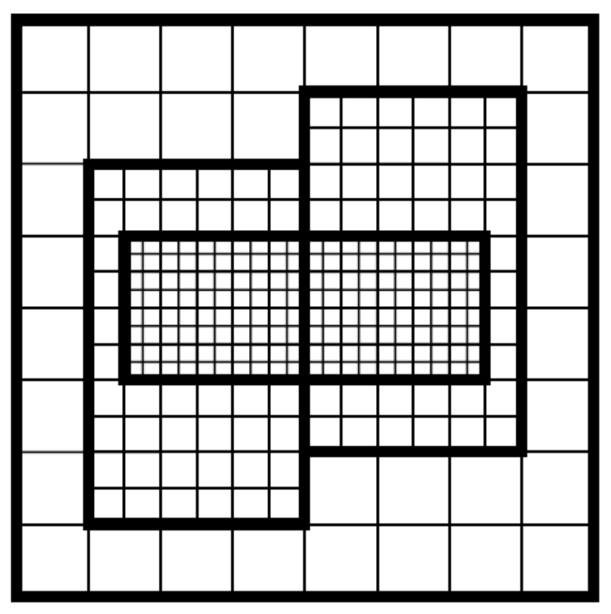
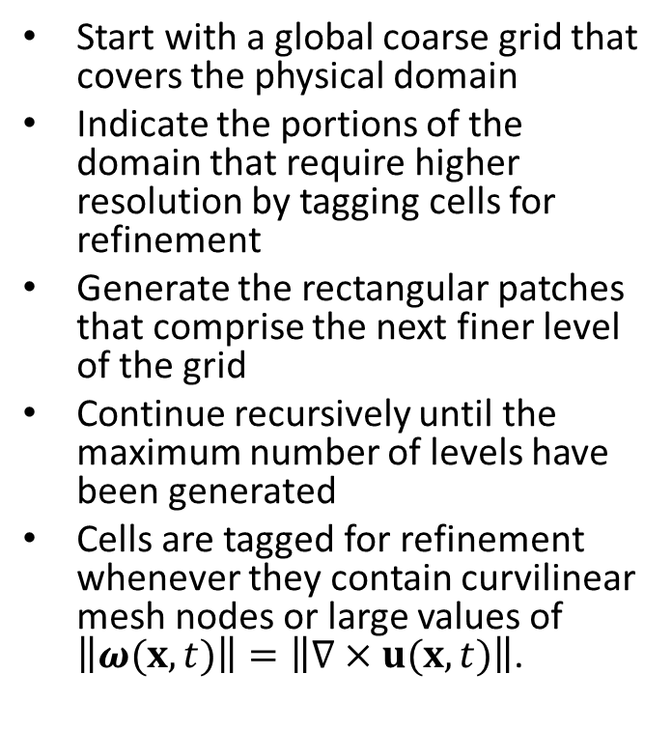
Adaptive mesh refinement (AMR)
Boyce Griffith, http://mbi.osu.edu/2009/ctwmaterials/griffith.pdf

Slide 30
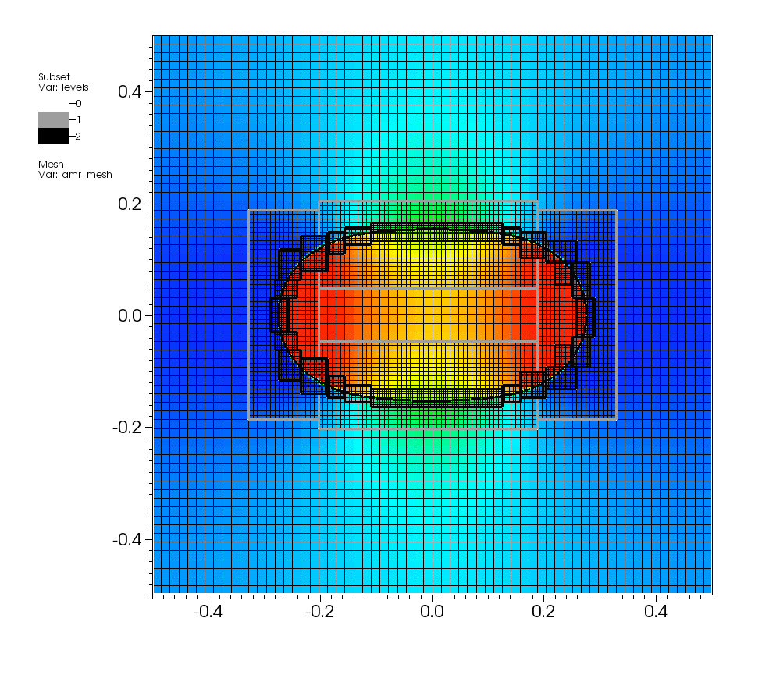
IBAMR for the rubber band problem
Boyce Griffith, http://mbi.osu.edu/2009/ctwmaterials/griffith.pdf

Slide 31
Appendix

Slide 32


Mathematical formulation
The IB formulation of the equations of motion for an elastic incompressible
structure immersed in a viscous, incompressible fluid is:
where x = (x, y) are fixed Cartesian (physical) coordinates, q is the Lagrangian (material) coordinate attached to the structure, X(q, t) is the physical position of material point q at time t, u is the Eulerian velocity field, and F is the Lagrangian elastic force density generated by deformations to the structure.
Notes:
Now on to the mathematical formulation. This is a direct numerical simulation, we solve the Navier Stokes equations with an added Eulerian elastic body force density with respect to the Eulerian coordinate system.
Fluid-structure coupling is done via integral transforms with delta function kernels.
1) First transform converts Lagrangian elastic force density into Eulerian elastic force density.
2) Second transform enforces that material point q moves at the local fluid velocity.
The lagrangian elastic force is obtained by looking at the deformation of the boundary, which could resist bending, stretching, and so on, with stiffness coefficients that change in time.

Slide 33




Lagrangian-Eulerian Interaction
Given the configuration of the elastic structure X(q, t) and the corresponding
curvilinear elastic force density F(q, t), the equivalent Eulerian elastic force
density f(x, t) is computed via:
where Ω denotes the curvilinear coordinate space and δ(x) = δ(x)δ(y) is
the two-dimensional Dirac delta function.
What does this mean? Integrate both sides over an arbitrary region .
1 or 0 depending on whether or not
Notes:
So if we are given the position of an elastic structure, X(q,t), we can compute the corresponding elastic force density, F(q,t) and then use this delta function transform to obtain the Eulerian elastic force density which gets plugged into the Navier-Stokes equations.

Slide 34


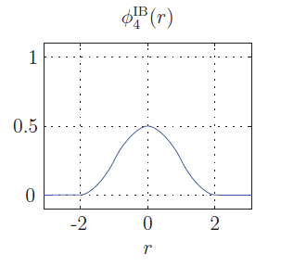
Smoothed approximations to the Dirac delta function
We define the regularized two-dimensional delta function as the product
of one-dimensional regularized delta functions:
What properties should φ(r) posses?
• Continuous
• Bounded support
• Discrete moment conditions
• Conservation of momentum/total force
• Conservation of angular momentum/torque
• Constraints to approximate grid independence
Notes:
In the numerical method, we use a regularized 2D delta function as the product of 1D regularized delta function.
Here is one such example which has the support of 4 Cartesian grid cells. Note r is the distance from the Lagrangian boundary.

